Slide 1
2 Layer Neural Network with the following structure: LINEAR -> RELU -> LINEAR -> SIGMOID
School of Computer Science and Engineering
Branch :- Artificial Intelligence and Data Science
Neural Networks and Deep Learning Laboratory Mini Project Presentation
NAME: FAIZAL HUSSAIN
SRN: R21EH124
BATCH: C1

Slide 2
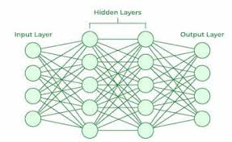
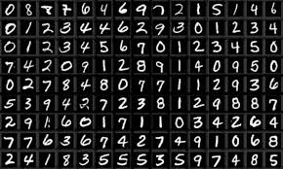
iNTRODUCTION
In today's digital age, the ability to accurately recognize handwritten digits has numerous applications, from automated form processing to digitizing historical documents. Our project aims to develop a robust and efficient system for recognizing handwritten digits using Neural Networks.

Slide 3
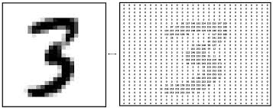
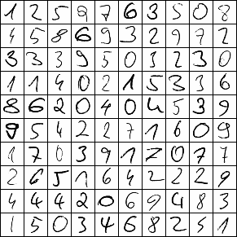
Problem statement
The problem of handwritten digit recognition poses several challenges, including variability in writing styles, noise in images, and the need for high accuracy. Traditional methods often struggle to achieve satisfactory results due to these complexities. Therefore, there is a need for advanced machine learning models capable of accurately identifying handwritten digits in various contexts.

Slide 4
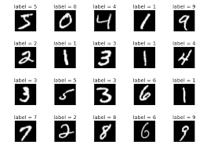
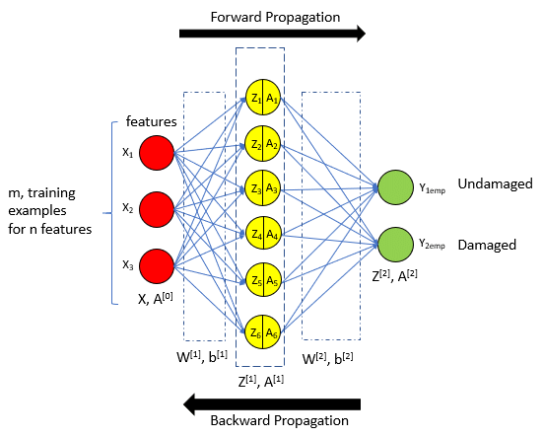
abstract
Our project focuses on developing a handwritten digit recognition system using a two-layer neural network architecture. We preprocess the data, train the model on the MNIST dataset, and evaluate its performance. Through our experimentation, we aim to demonstrate the effectiveness of neural networks in accurately recognizing handwritten digits and highlight their potential for real-world applications.

Slide 5
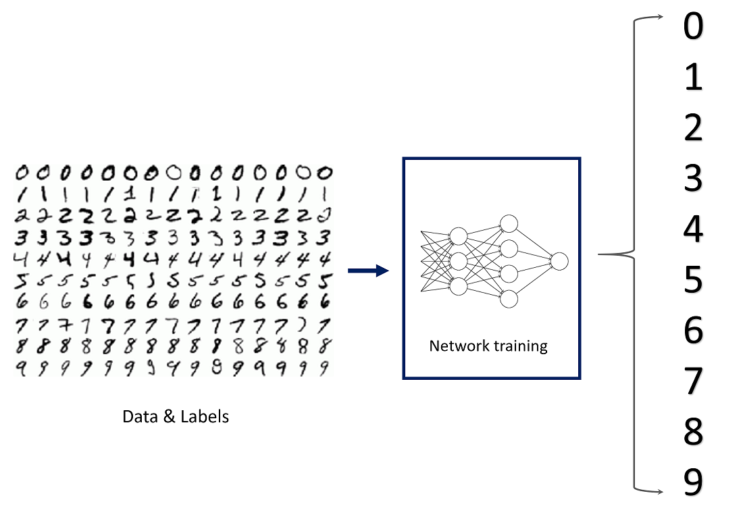
methodology
Our methodology involves several steps, including data preprocessing, model development, training, evaluation, and optimization. We preprocess the images to standardize their size and intensity values. We then develop a two-layer neural network model using Keras, a popular deep learning framework. After training the model on the MNIST dataset, we evaluate its performance using metrics such as accuracy and loss.

Slide 6
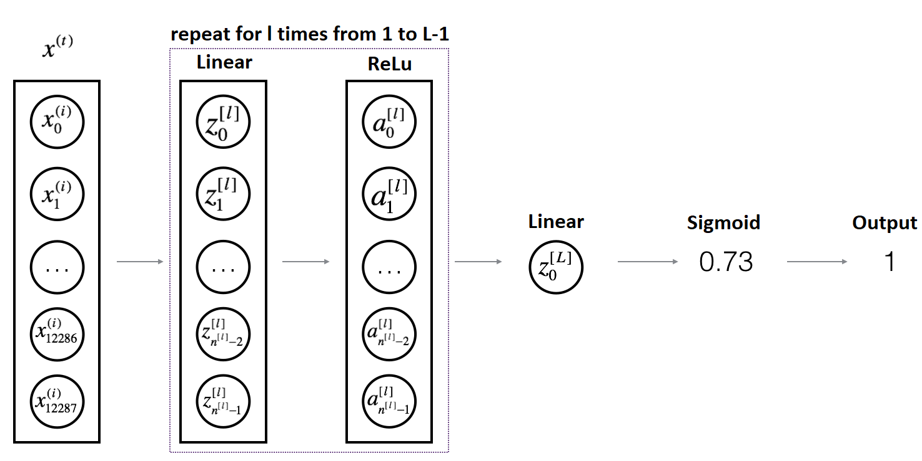
architecture
Our handwritten digit recognition system is built on a two-layer neural network architecture. The first layer is a linear layer followed by a ReLU activation function, while the second layer is a linear layer followed by a sigmoid activation function. This architecture allows the model to effectively capture features from the input images and make accurate predictions.
LINEAR -> RELU -> LINEAR -> SIGMOID

Slide 7



Tech stack (libraries)
We utilized several libraries and tools in our project, including TensorFlow/Keras for neural network implementation, NumPy for numerical computations, and Matplotlib for data visualization. These libraries provided us with the necessary tools to develop and evaluate our handwritten digit recognition system efficiently.

Slide 8
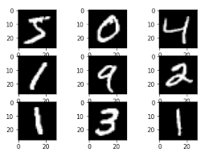
Dataset used
Our project utilizes the MNIST dataset, a widely used benchmark dataset in the machine learning community for handwritten digit recognition. The dataset consists of 60,000 training images and 10,000 testing images, each representing a grayscale image of a handwritten digit (0-9). The MNIST dataset is instrumental in benchmarking the performance of various machine learning models for digit recognition tasks.

Slide 9
Literature survey
LeCun, Y., Cortes, C., & Burges, C. J. (2010). MNIST handwritten digit database.
presented the MNIST dataset, a benchmark for handwritten digit recognition. The paper outlines dataset details, including preprocessing steps, and highlights its widespread use in evaluating machine learning algorithms, particularly neural networks. MNIST's simplicity and relevance have propelled advancements in image classification and served as a foundational resource for studying deep learning methods.

Slide 10
Literature survey
He, K., Zhang, X., Ren, S., & Sun, J. (2016). Deep residual learning for image recognition.
This paper introduces residual networks (ResNets), a deep learning architecture that addresses the problem of vanishing gradients in very deep neural networks. ResNets utilize residual connections to enable the training of extremely deep networks, leading to improved performance on image recognition tasks.

Slide 11
Literature survey
Nwankpa, M., Nwankpa, H. I., Haider, S. I., & King, R. C. (2018). A Survey of Activation Functions in Deep Learning: ReLU and Beyond.
This paper offers a comprehensive examination of the Rectified Linear Unit (ReLU) activation function and its variants, discussing their mathematical foundations, architectural implementations, and diverse applications in fields like computer vision and natural language processing. It emphasizes the crucial role of ReLU and its variants in enhancing neural network performance and advocates for continued exploration into their optimization techniques for achieving state-of-the-art results.

Slide 12
Literature survey
"Rectified Linear Units Improve Restricted Boltzmann Machines" by Vinod Nair and Geoffrey E. Hinton (2010)
This paper explores the advantages of using rectified linear units (ReLU) as activation functions in neural networks, including two-layer networks. It discusses how ReLU can mitigate the vanishing gradient problem and accelerate training.

Slide 13
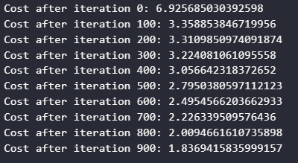
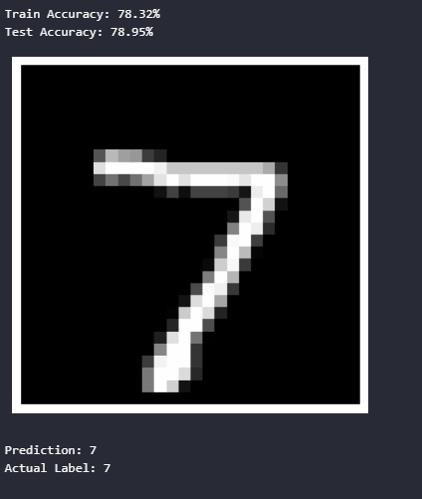
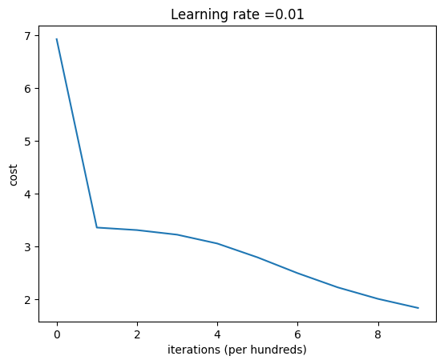
output

Slide 14
conclusion
In conclusion, our project demonstrates the effectiveness of neural networks in accurately recognizing handwritten digits. By leveraging advanced Deep learning techniques and the MNIST dataset, we have developed a robust and efficient handwritten digit recognition system. Our findings highlight the potential of neural networks in solving complex image classification tasks and pave the way for future research in this domain.

Slide 15
references
LeCun, Y., Cortes, C., & Burges, C. J. (2010). MNIST handwritten digit database.
He, K., Zhang, X., Ren, S., & Sun, J. (2016). Deep residual learning for image recognition.
Nwankpa, M., Nwankpa, H. I., Haider, S. I., & King, R. C. (2018). A Survey of Activation Functions in Deep Learning: ReLU and Beyond.
"Rectified Linear Units Improve Restricted Boltzmann Machines" by Vinod Nair and Geoffrey E. Hinton (2010)

